Slide 1
Student Record system
C++ Mini Project for Summer Internship 2022

Slide 2
CONTENTS
Introduction
Objective
Features
Requirements
Algorithm
Interface

Slide 3
INTRODUCTION
This project enables the user to store information about students with different attributes. The goal was to implement core C++ concepts like handling loops, control statements, file handling, and much more. The project is a console application and the logic is written in C++.
The program makes use of different functions to perform its functions which include storing, fetching, and deleting records. All the data is stored in a text file and each entry is stored in the following line.
The program also verifies the user based on a username and password combination. The program will cease to execute if the credentials are incorrect.

Slide 4
Objective
1. Build a user-friendly application. 2. Provide best user experience. 3. Store and retrieve data efficiently. 4. Write the data to file so that it will not be lost after the session is over. 5. Using well defined functions. 6. Implementing good coding practices. 7. Store, retrieve and delete data using well defined functions. 8. Implementing reusability of code.

Slide 5
Features
User Authentication
Lightweight & Fast
CRUD Operations.
Helpful Error Messages
Configurable code
Less hardware and software requirements

Slide 6
Requirements
Tested on a PC having following specs:
Ryzen 3 3250
AMD Radeon Vega 3 Graphics
8GB RAM
256GB SSD
Standard PS/2 Keyboard
Windows 10 Pro 2021

Slide 7





Algorithm
Step 1
Step 2
Step 3
Step 4
Step 5
Display Login Screen:
If credentials match display menu: else display login screen again
Display Menu Items:
Add
Search
Display All
Delete
Exit
Scan input and make call the required function.
Get the input from the user if needed and display the output.
Return to the main menu loop, after the task has been accomplished.

Slide 8
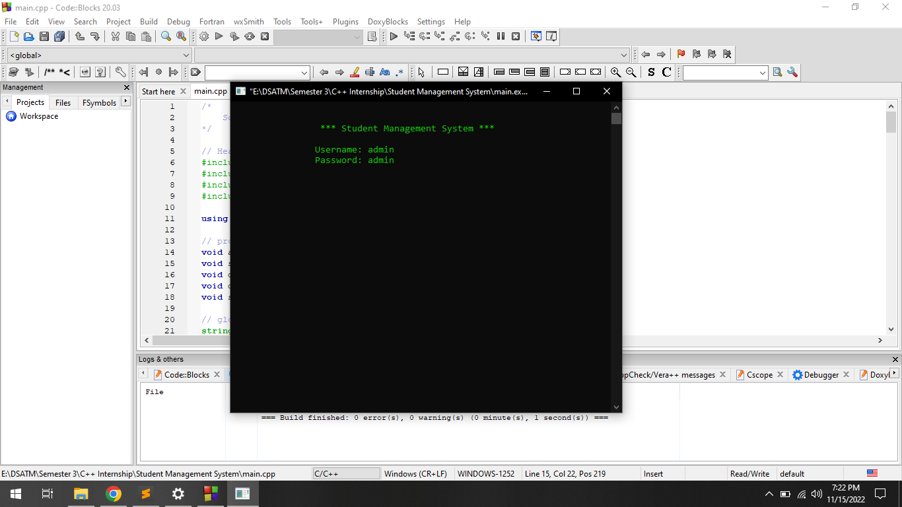
Interface
Login Screen

Slide 9
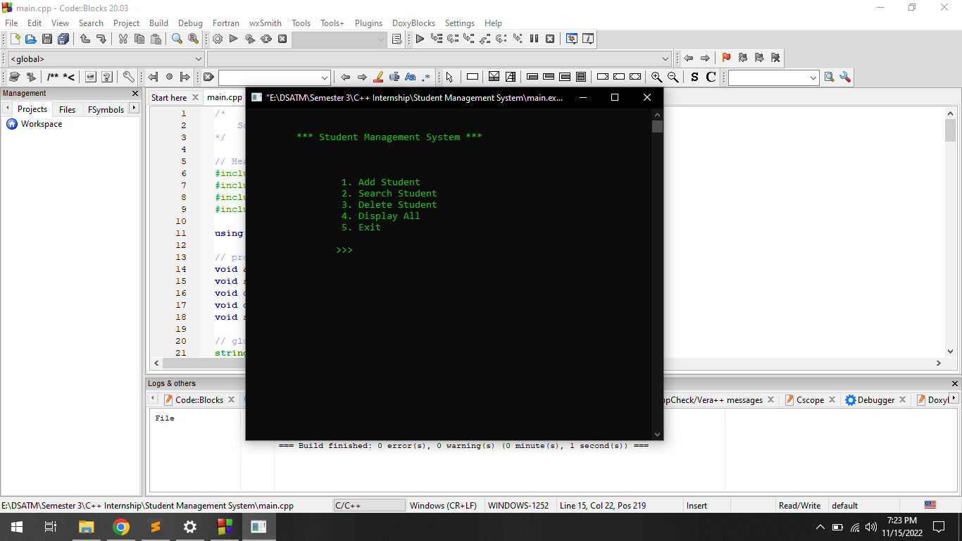
Interface
Main Menu

Slide 10
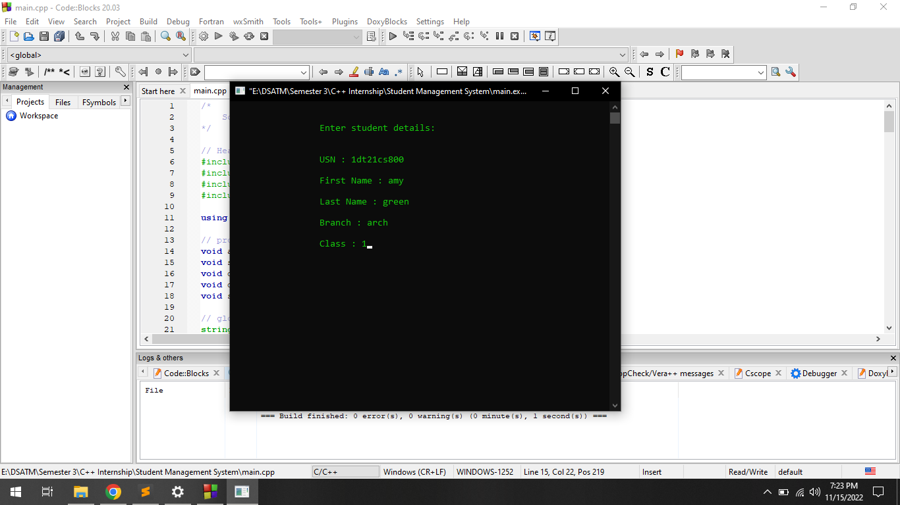
Interface
Add Student

Slide 11
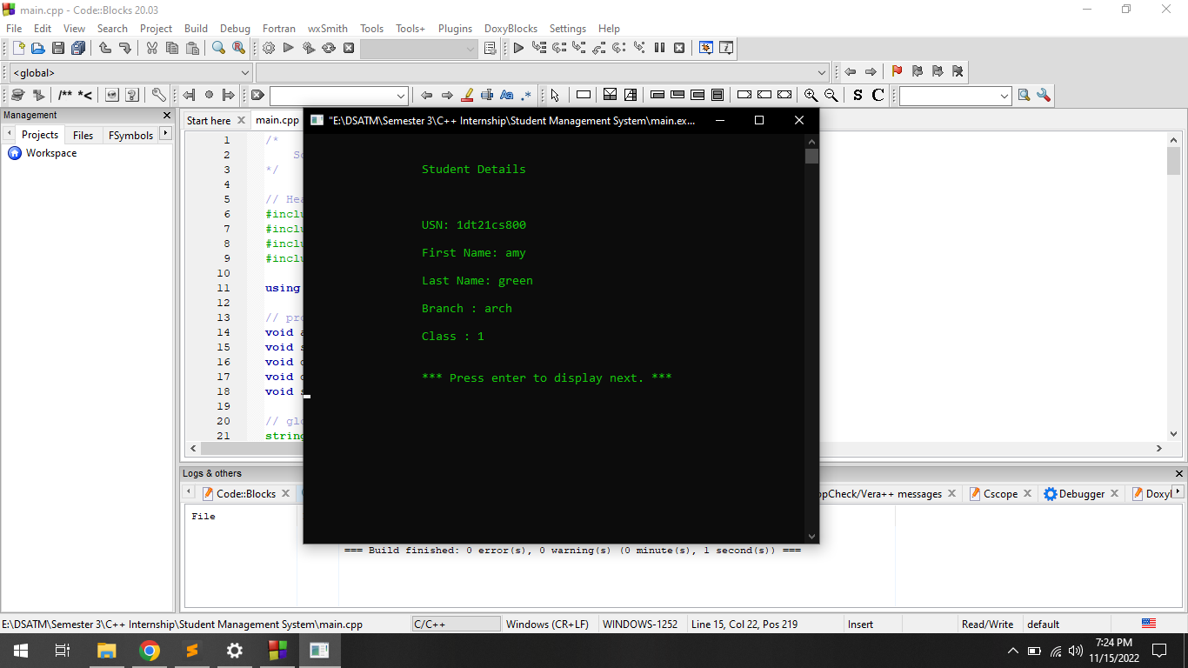
Interface
Display All

Slide 12
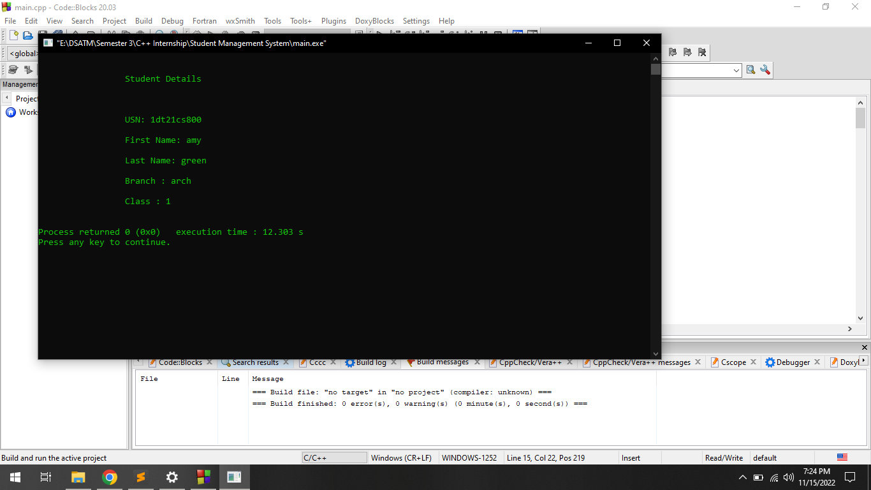
Interface
Search Student

Slide 13
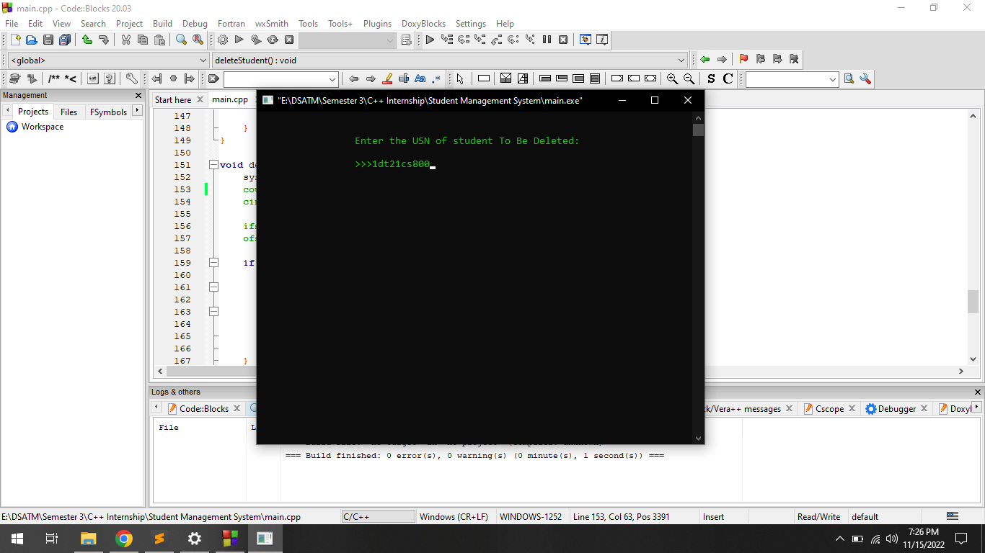
Interface
Delete Student

Slide 14
THANK YOU
Sahil Showkat
Preyushi Abrol
Mohin Khan

